Slide 1
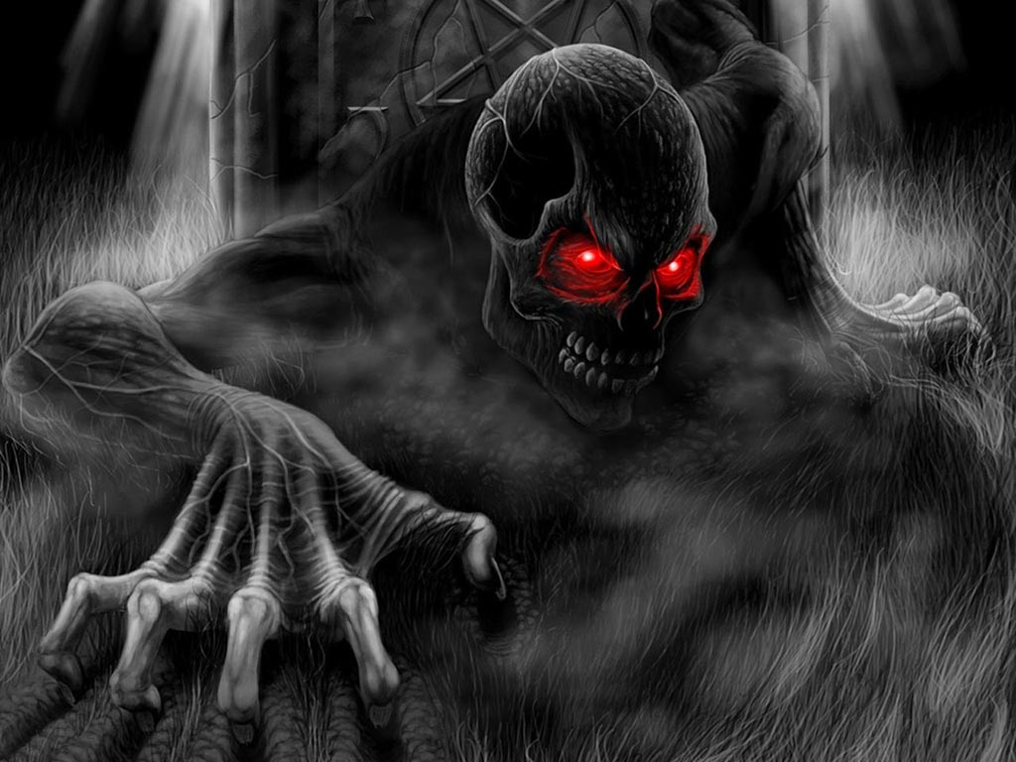
play
initiation
exit

Slide 3
Continuar a la
pregunta numero 2
Continuar la pregunta
numero 3
Continuar a la
Pregunta 4
initiation

Slide 4
Continuar a la
pregunta numero 2
won
Continuar a la
Pregunta 4
Continuar a la
pregunta numero 3
initiation

Slide 5
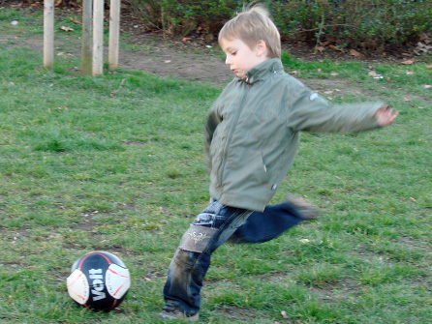
hh
still not win the first answer the following questions. in the way you met certain colors that identified a riddle why answers:
responds according to the image
He is
Soccer.
a. playing
b. plays
c. Have played

Slide 6
dsds
He is
In the night
In my house
a. sleeping
b. sleeps
c. Has sleeped

Slide 7
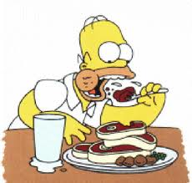
gh
he is
In a restaurant.
a. eating
b. eats
c. Have eated

Slide 8
hbj
She like
Ice of chocolate.
a. eats
b. eating
c. Have eated

