Slide 1
Game
Alejandra cocoma
Diana sanches

Slide 2
crossword
Cross Down
1.Question in present 2. question in present
simple in plural simple singular
3.Question in present 4. present that express the idea that
Continuous in plural something is happening now
5. added to the verb in 6. person singular, add an "S" to the verb
present continuous

Slide 3
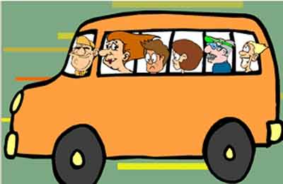
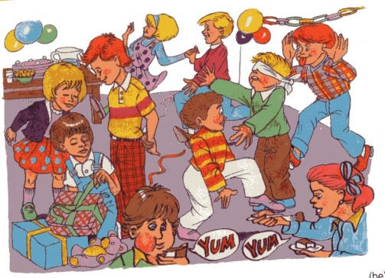
Present simple and
continuous
P
R
4
E
S
routines
E
6
N
T
P
R
Action is happening in the moment
E
S
C
D
O
E
N
1
N
T
T
S
5
N G
I
N
2
D
O
I
M
U
O
E
S
p
U
l
3
A R
E

