Slide 1
Present Simple and Progressive
Laura Carolina León Gómez
10A

Slide 2
Content
Present Simple
Present Progressive
Activity
Present Simple
Present Progressive

Slide 3
Present Simple
Use to express routines, habits, like or dislike
Do I Does She
You He
They It
We
Activity

Slide 4
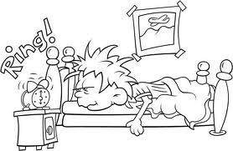
Present Simple
Select the correct form.
Does we read a magazine?
Do she a read a magazine?
Does he read a magazine?
Does I read a magazine?
Select the correct form.
He wakes up at 6:00 am
We wakes up at 6:00 am
She wake up at 6:00 am
They wake up at 6:00 am
Content

Slide 5
Present simple

Slide 6
Present simple

Slide 7
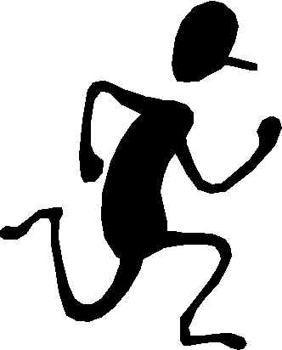
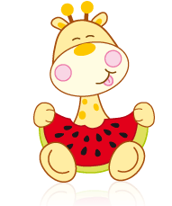
Present Progressive
Use the actions is happenig in the moment in which you are talking.
Am Is He Are You
I She We
It They
Activity

Slide 8
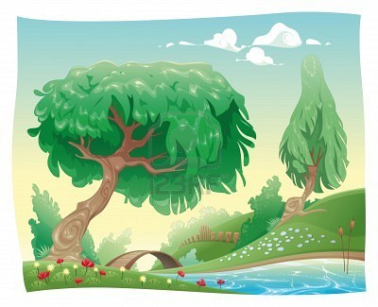
Present Progressive
Select the correct form.
Are I play in the park?
Is we plaing in the park?
Am I playing in the park?
Am you playing in the park?
Select the correct form.
The theacher are speakying Spanish
The theacher is speaking Spanish
The theacher are speaky Spanish
The theacher is speakying Spanish
Content

Slide 9
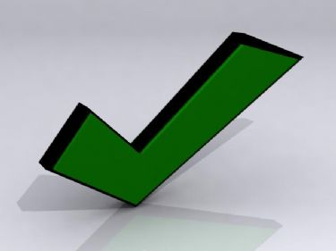
Present progressive
Thanks

Slide 10
Present progressive
Thanks

