Slide 1
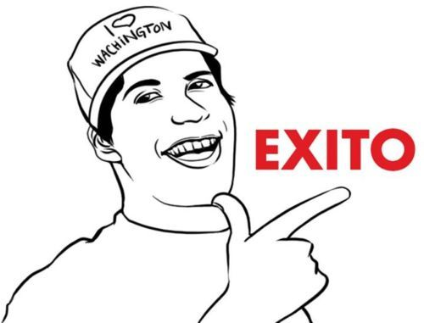
PHOTOCOPIES FOR PRESENTS
game
Laura Vélez c.
DIANA FUENTES

Slide 2
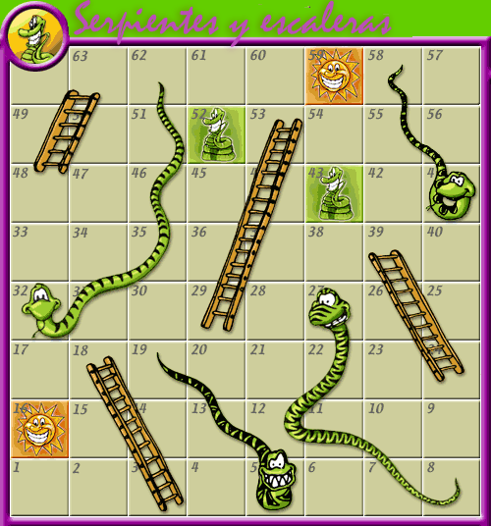

Slide 3
PRESENT PROGRESSIVE
PRESENT SIMPLE
¿Which is the use of Present Progressive?
¿Which is the structure of Present Progressive in a positive form ?
¿ What way should be the verb in present progressive?
¿Which is the structure of Present Progressive in negative form ?
Answers:
The action is happening in the moment in which you are toking.
Subject+to be verb (present)+ verb+ing+complement.
Verb in present with ing.
Subject+to be verb in negative form+principal verb+ ing+complemet.
1. ¿Which is the structure of Present Simple in a negative form?
¿Which is the auxiliary verb?
When the sentences are in positive form ¿What happens to be verbs (he, she and it)?
¿Which is the use of Present Simple?
Anwers:
1. Subject+auxiliary verb (negative form) +principal verb+complement.
2. Do and Does
3. Is added to the ”s”
4. To express routines, habbits, likes or dislikes.
THROW THE DICE AGAIN
LOSE A TURN

