Slide 1
COMPOUND VERBS GALLERY
Daniel Bustamante Osorio H
10B

Slide 2
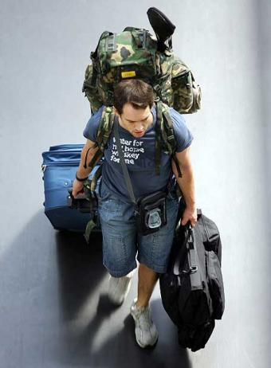
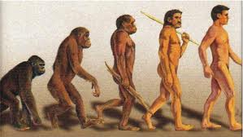
Come From
This verb means (VENIR) is more or less proceed or be in a place to come after another.

Slide 3
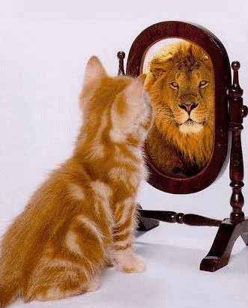
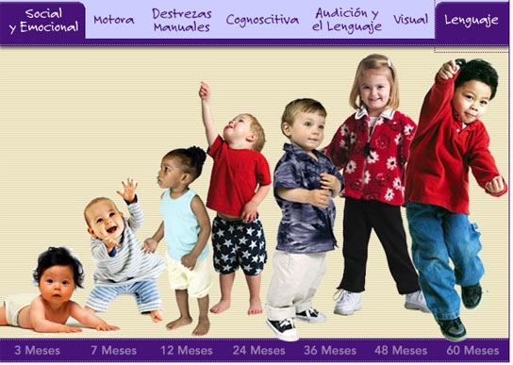
Grow up
This verb means (CRECER), to be great both in age and stature, be more male or female.

Slide 4
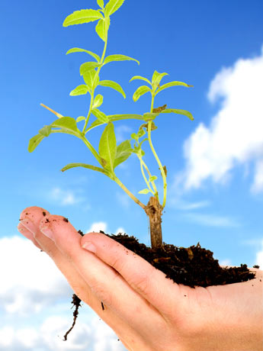
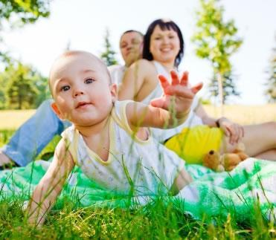
Look After
This verb means (CUIDAR), may be taking care of something in particular or simply protecting some property.

Slide 5
Look For
This verb means (BUSCAR), something lost or something necessary to perform an activity intended.

Slide 6
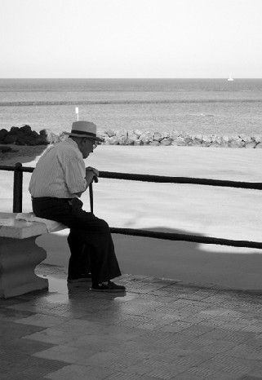
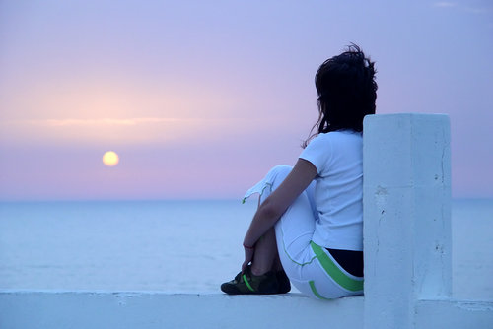
Look forward to
This verb means (ESPERAR), in a given time waiting for someone or some person or object, wait any qualifications or event.

Slide 7
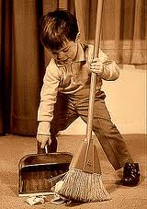
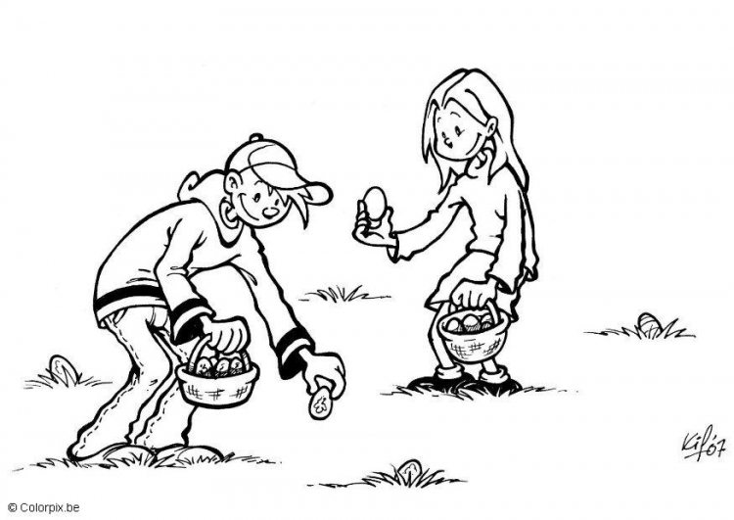
Pick up
This verb means (RECOGER), a person in a certain area or pick up a job.

Slide 8
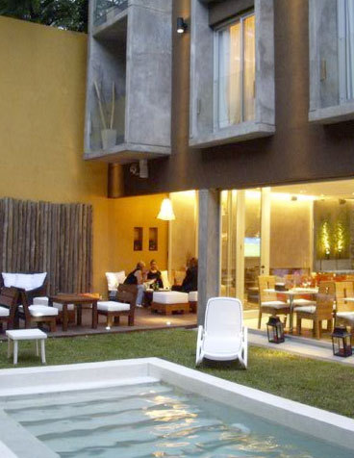
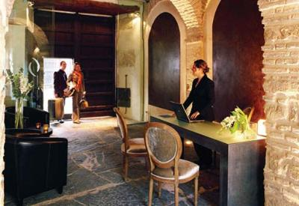
Stay at
This verb means (HOSPEDARSE), in a hotel on holiday or temporarily place a house.

Slide 9
Carry on
This verb means (CONTINUAR) can be understood as follow what he was doing, or standing in one occasion and keep doing better than before.

Slide 10
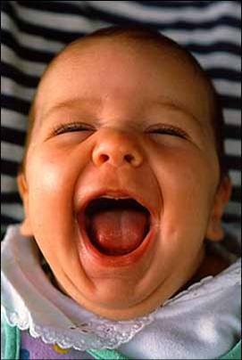
Burst out (laughing)
This verb means (A REVENTAR (SE RIE )), is laughing so suspicious, in the form of laughter.

Slide 11
Deal with
This verb means (HACER FRETE A ), addressing the issues, or just take care of someone or something causing a problem or or question.

Slide 12
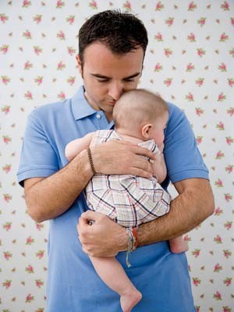
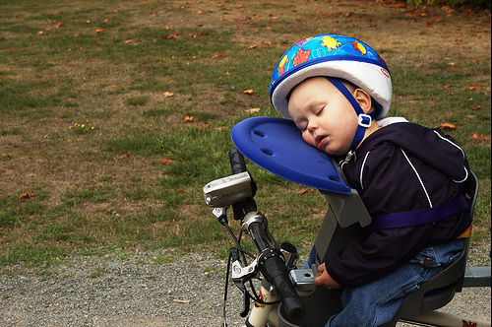
Fall asleep
This verb means (DORMIRSE), somewhere or somewhere appropriate lack of energy.

Slide 13
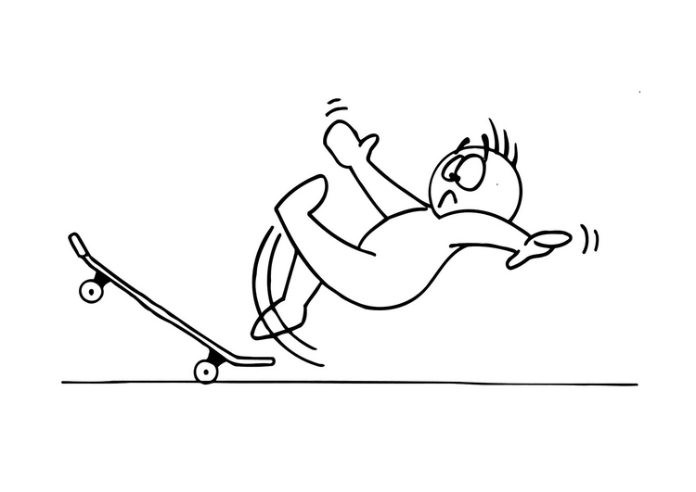
Fall down
This verb means (CAERSE ), falling from some object or performing some action.

Slide 14
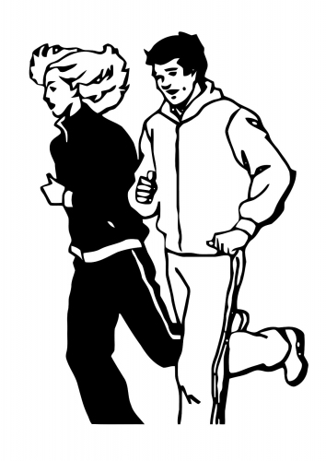
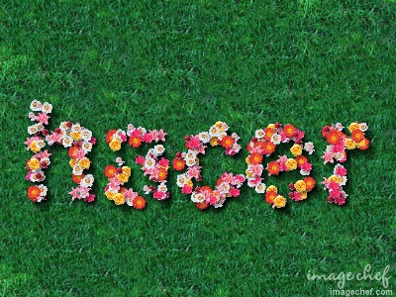
Make up
This verb means (HACER), can be interpreted as exercising or performing different activities or tasks.

Slide 15
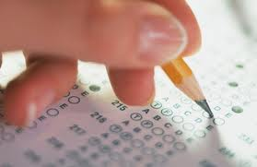
Take(somedbody)around
This verb means ( TOME (A ALGUIEN ) EN TORNO A ), or choose to take someone or something for a moment.

Slide 16
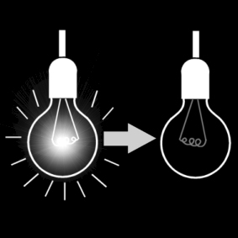
Turn off
This verb means (APAGAR), an object like a computer or my own phone.

Slide 17
Wake up
This verb means (DESPERTARSE), this can be interpreted as an action to open the eyes to get out of bed

Slide 18
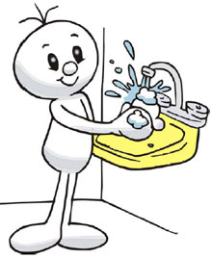
Wash up
This verb means (LAVARSE), self can clean certain areas of the body.

Slide 19
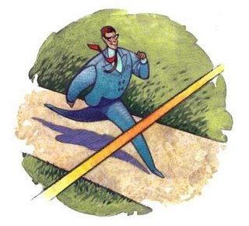
Catch up
The meaning of this verb is (ALCANZAR), reach for someone or something.

Slide 20
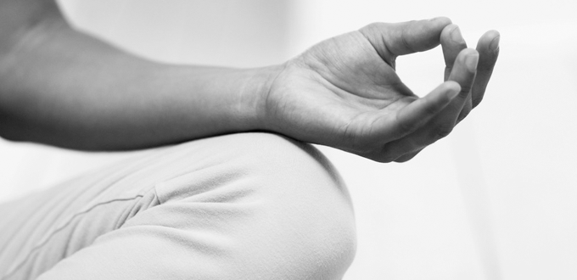
Chill out
This means (RELAJAR), which included many I like is to be at peace inside without including work tasks.

Slide 21
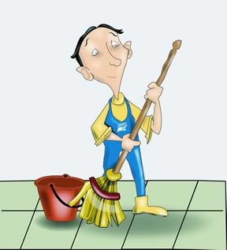
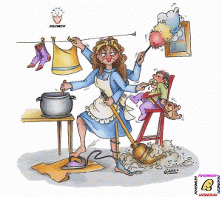
Clear out
This means (LIMPIAR), an activity that almost nobody likes but you have to do it, this is a verb.

Slide 22
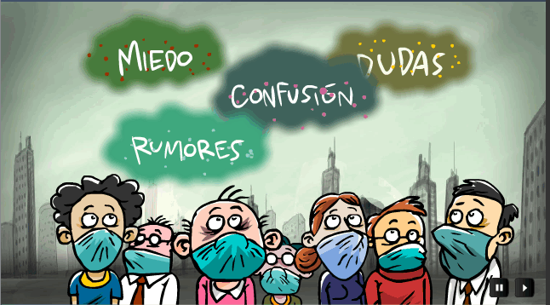
Clear up
You can have multiple meanings (ACLARAR), doubts, clarify the day but if it answers questions concerning any subject.

Slide 23
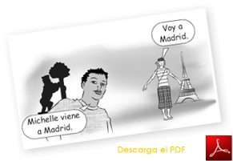
Come Round
This verb means (VENIR), whether it is arriving or go somewhere or site.

Slide 24
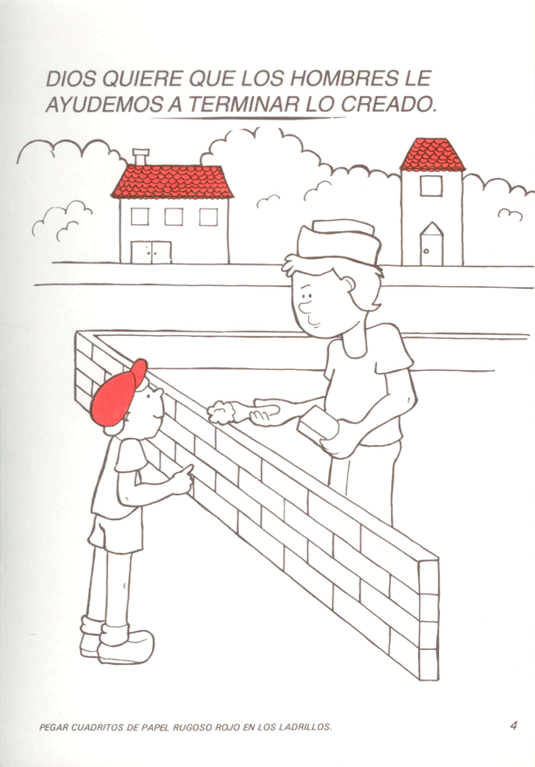
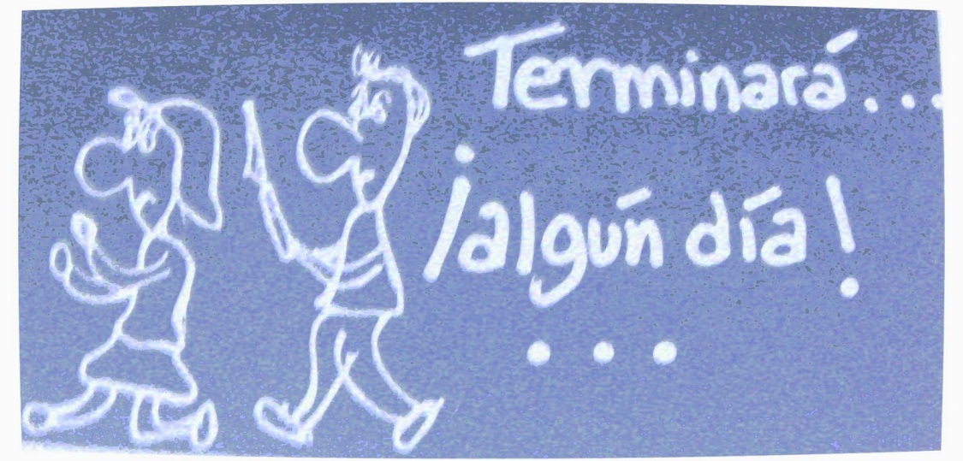
End up
This verb means (TERMINAR), an activity designed.

Slide 25
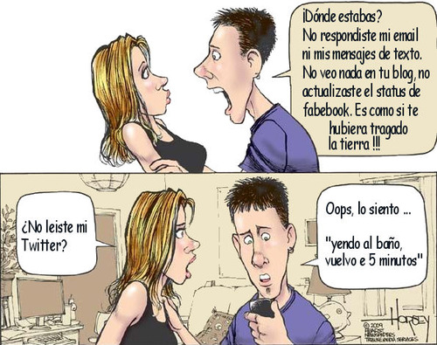
Find out
This verb means (AVERIGUAR), a theme, something or an event.

Slide 26
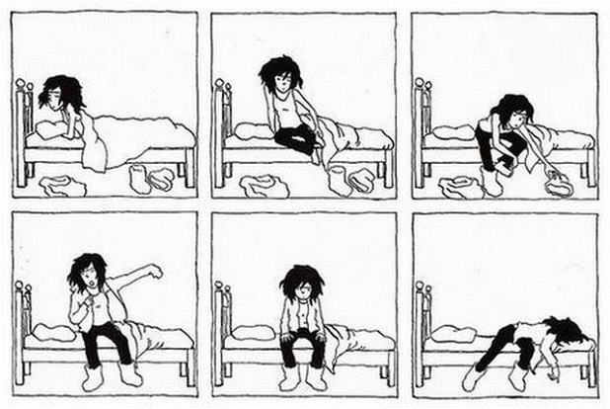
Get out( of bed )
This verb means (SALIR (DE LA CAMA )), is basically a synonym or fold up your own bed.

Slide 27
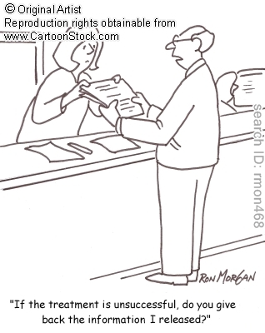
Give back
This verb means (DEVOLVER), either silver or something that is not yours or just something you have borrowed, or back to back.

Slide 28
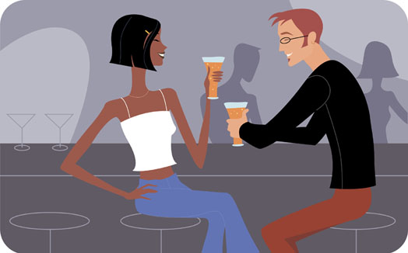
Go out ( of bed )
This verb means (SALIR (CON)), someone in any occasion.

Slide 29
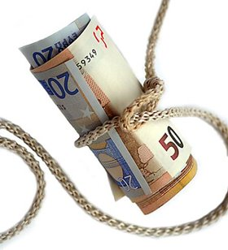
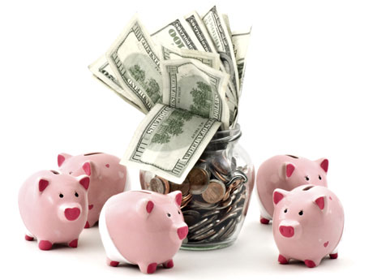
Save up
This verb means (AHORRAR), to care is to keep different things that can be retrieved later use.

Slide 30
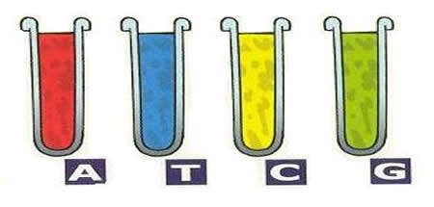
Sort out
This verb means (CLASIFICAR), any object into good and bad, harmful or healthy.

Slide 31
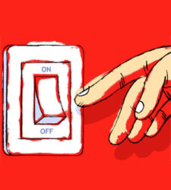
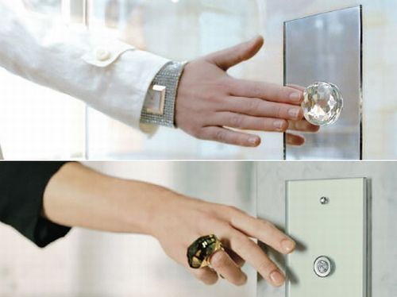
Switch off
This verb means (APAGAR SWITCH), may be to save energy.

Slide 32
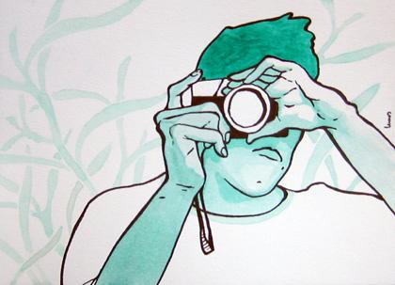
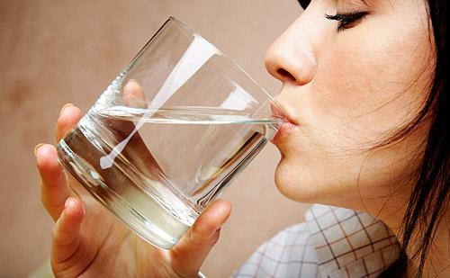
Take up
This verb means (TOMAR), has several meanings such as decision making, taking or drinking water, taking photographs.

Slide 33
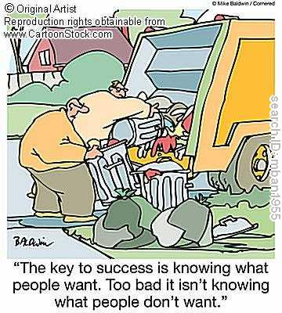
Throw out
This verb means (TIRAR), in various fields can be said to throw the ball, or littering.

Slide 34
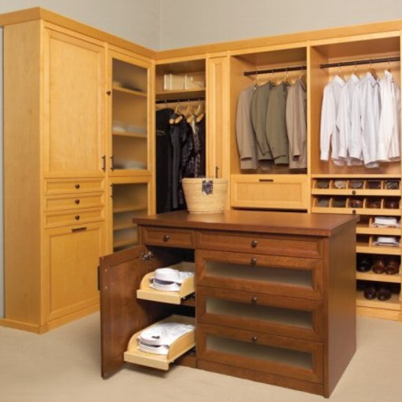
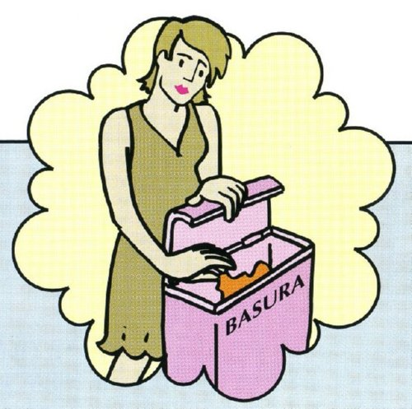
Tidy up
This verb means (PONER EN ORDEN ), order a room or place.

Slide 35
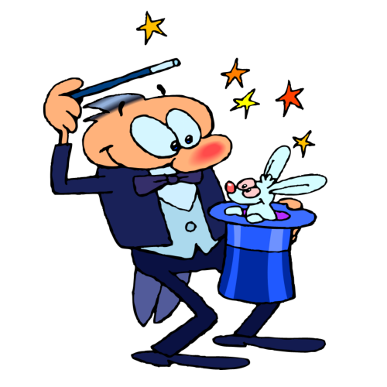
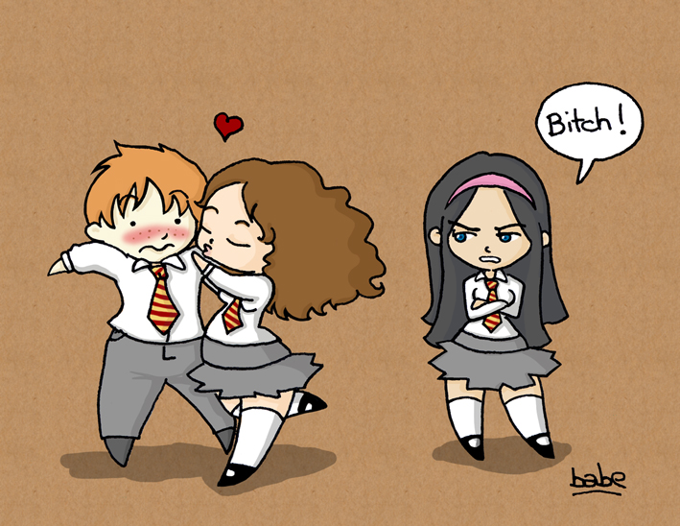
Turn up
This verb means (APARECER), in a particular place or in part.

Slide 36
Thanks

