Slide 1
Digital album.

Slide 2
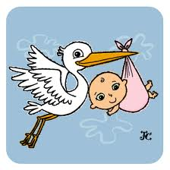
Come From
“Venir de”

Slide 3
Find out
“Descubrir “

Slide 4
Grow up
“Crecer “

Slide 5
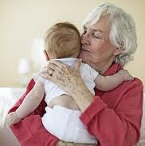
Look after
“Cuidar”

Slide 6
Look for
“Buscar”

Slide 7
Look forward to
“Esperar”

Slide 8
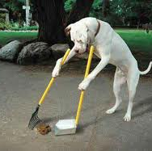
Pick up
“Recoger”

Slide 9
Stay up
Mantenerse

Slide 10
Carry on
Llevar a cabo

Slide 11
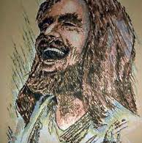
Burst out (laughing)
Irrumpir (reir)

Slide 12
Deal whit
tratar

Slide 13
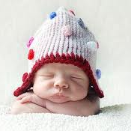
Fall asleep
Conciliar el sueño

Slide 14
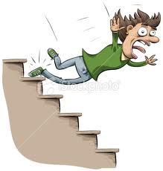
Fall down
Caer

Slide 15
Look after
Cuidar

Slide 16
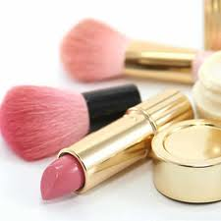
Make up
Maquillaje

Slide 17
Take (somebody) around
Tomar (a alguien)
Alrededor

Slide 18
Turn off
Apagar

Slide 19
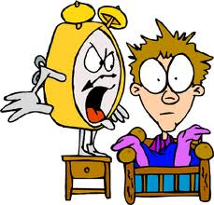
Wake up
Despertarse

Slide 20
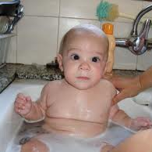
Wash up
lavarse

Slide 21
Catch up
Alcanzar

Slide 22
Chill out
Relajarse

Slide 23
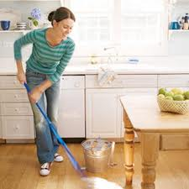
Clear out
Limpiar

Slide 24
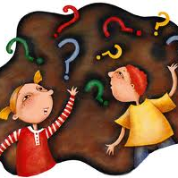
Clear up
Aclarar

Slide 25
Come round
Venir

Slide 26
End up
Terminar

Slide 27
Find out
Averiguar

Slide 28
Get out (of bed)
Salir (de la cama)

Slide 29
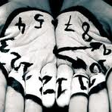
Give back
Devolver

Slide 30
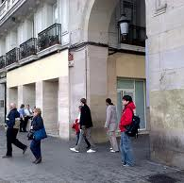
Go out (with)
Salir (con)

Slide 31
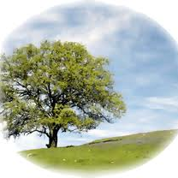
Grow up
Crecer

Slide 32
Save up
Ahorrar

Slide 33
Sort up
Ordenar por

Slide 34
Stay up
Mantenerse

Slide 35
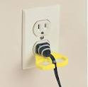
Switch off
Desconectar

Slide 36
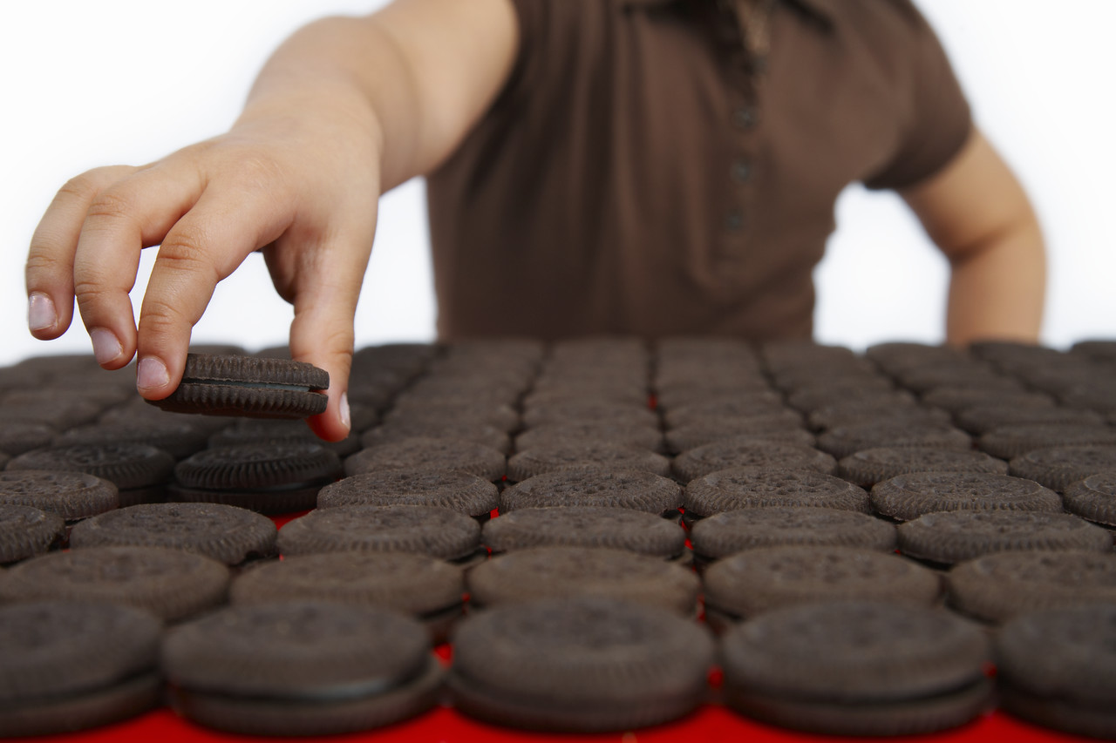
Take up
Tomar

