Slide 1
Carolyn Walker
T
H
E
B
E
A
S
T

Slide 2
Characters
Susie
Charlie
Tom a farmer

Slide 3
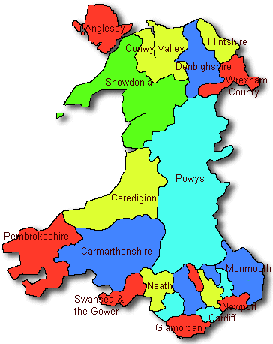
a couple very worried about her job and decided to take a holiday in South Wales in a town called Llandafydd.

Slide 4
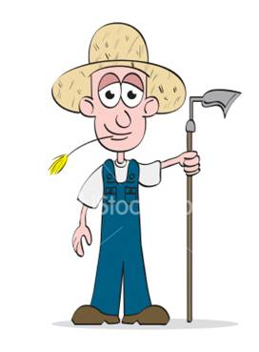
Tom a farmer near the place where they stayed, went to look for hismissing sheep, but found dead.

Slide 5
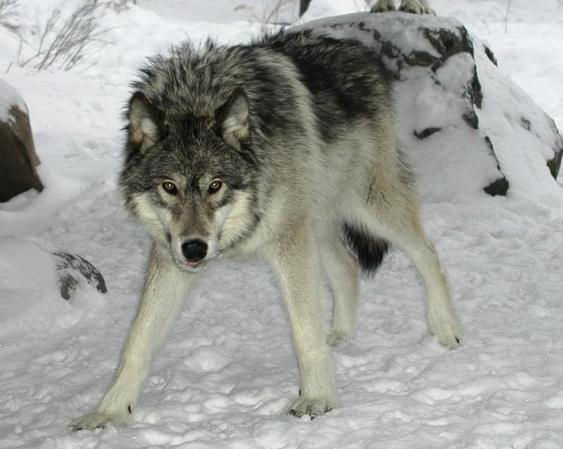
Tom to prevent more sheep die decided to go check them and suddenly a huge wolf was devouring a sheep.

Slide 6
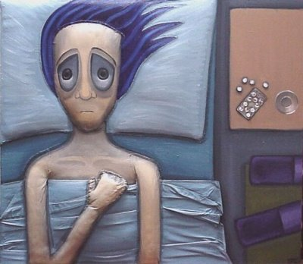
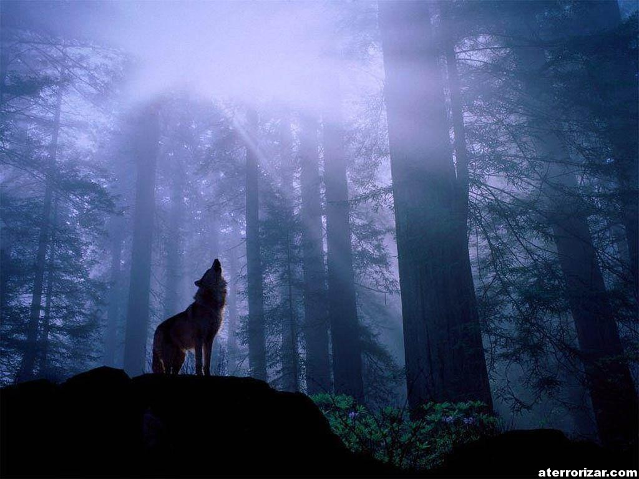
The first night, susie could not sleep because of noise, charlie is look out the cabin door. and I am surprised.

Slide 7
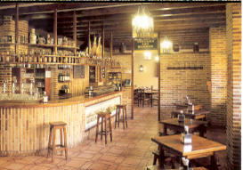
Charlie saw a sheep in front of the door, scared, call Susie and went to a tavern.

Slide 8
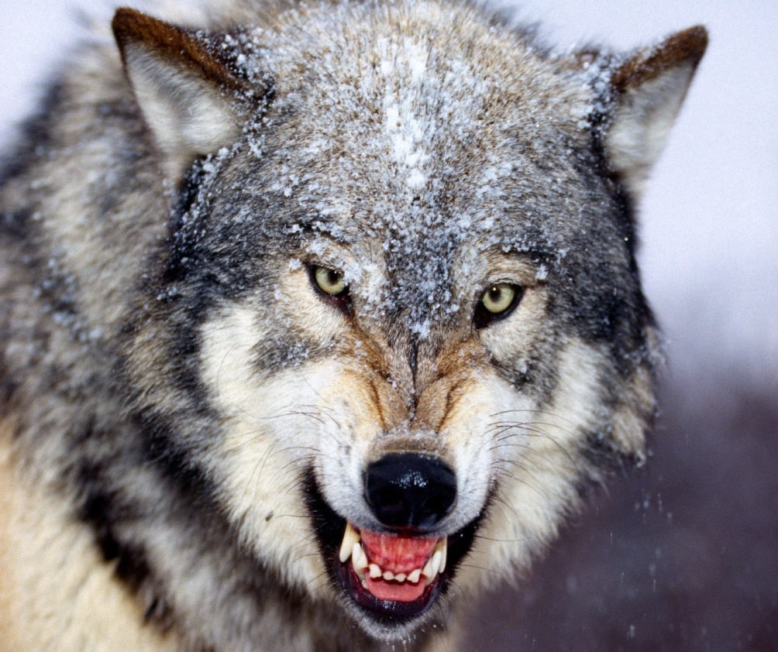
upon returning home found the farmer tom wounded, Charlie went to seek help, then the beast came back.

Slide 9
Susie is kidnapped by a wolf, after tom help the farmer to escape the bite of the wolf that terrorized the village where they were staying.

Slide 10
Lina Alejandra Orozco Velandia 10 B
thanks

