Slide 1
PHRASAL VERBS….
Camila A. Gámez
Decimo b

Slide 2
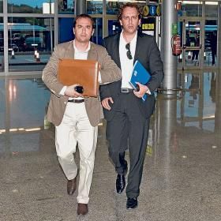
Come from:
They come from of the bank

Slide 3
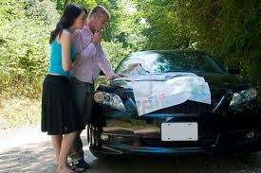
Find out:
They find out the correct route

Slide 4
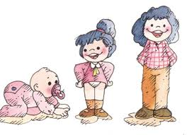
Grow up:
She grow up each year

Slide 5
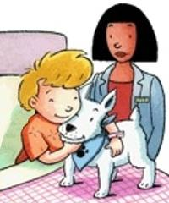
Look after:
He look after its dog

Slide 6
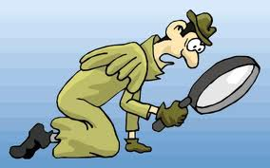
Look for:
He look for a track

Slide 7
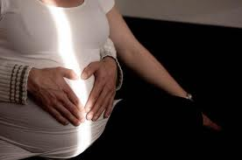
Look forward to:
She look forward to a baby

Slide 8
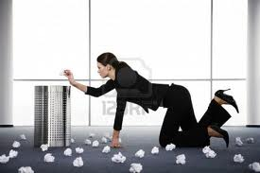
Pick out:
She pick up the papers

Slide 9
Stay up:
She is stay up in form

Slide 10
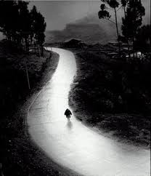
Carry on:
She carry on their way

Slide 11
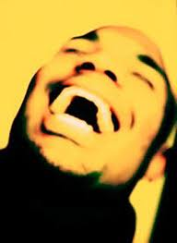
Burst out:
He is burst out of laughter

Slide 12
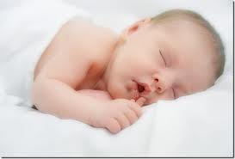
Fall asleep:
He just of fall asleep

Slide 13
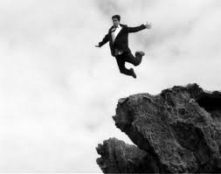
Fall Down:
He fall down to vacuo

Slide 14
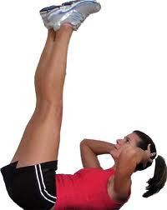
Make up:
She likes make up exercise

Slide 15
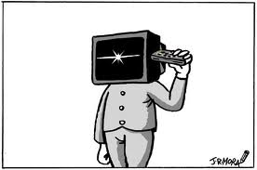
Turn off:
He turn off the TV

Slide 16
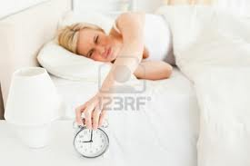
Wake up:
She want not wake up

Slide 17
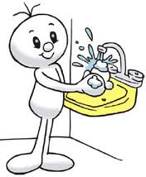
Wash up:
He likes wash up the hands

Slide 18
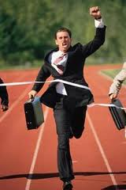
Catch up:
He achieved catch up your goat

Slide 19
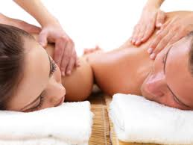
Chill out:
They its chill out in the SPA

